Slide 1
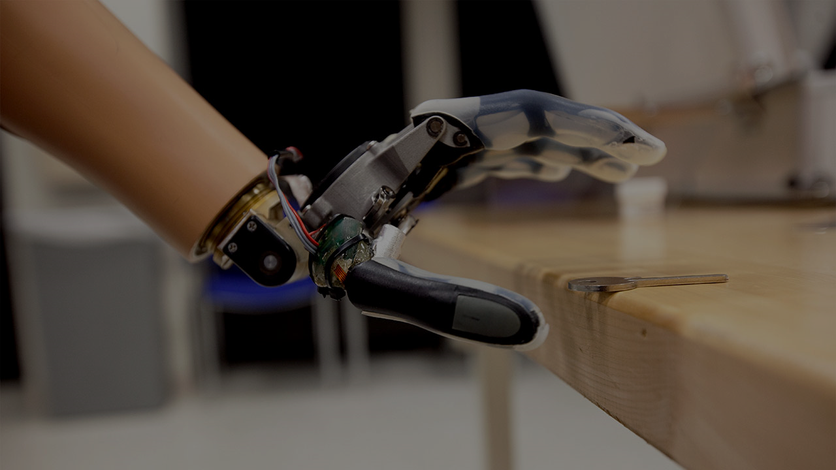
Robust and Reliable Motion and Gesture Recognition
from Surface Electromyography (sEMG) Signals
Pouya Pourakbarian Niaz
Notes:
Surface Electromyography (sEMG) is a technology used for evaluating and recording the electrical activity produced by skeletal muscles without invading or puncturing the skin.
Due to the immense complexity and high-frequency outputs of the activations occurring in skeletal muscles, sEMG signals that are recorded from the sensors are not trivial to process or decompose.
Even after preliminary amplification and band-pass filtering, extracting meaningful features from the processed signals is difficult, especially when trying to recognize motion/gesture or when trying to estimate muscle force or human effort from sEMG signals.
Therefore, modern approaches in (pre)processing sEMG signals often combine several signals processing, machine learning, and deep learning approaches are needed to address the issue.

Slide 2
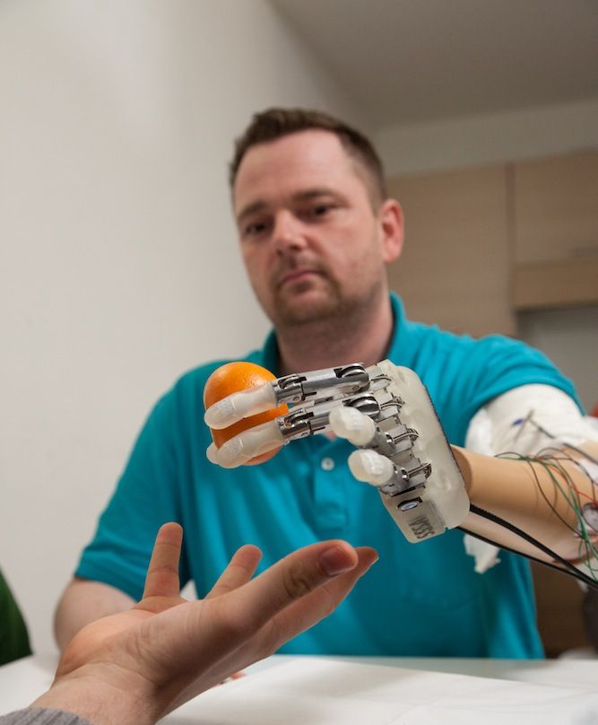
Giving a hand amputee the ability to control a prosthetic hand
(robotic hand)

Slide 3
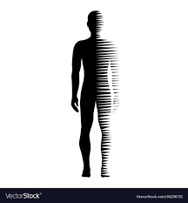

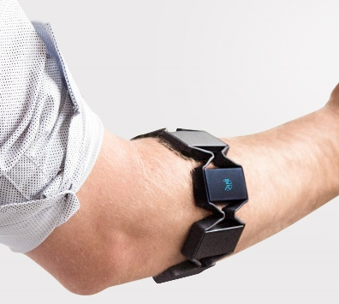
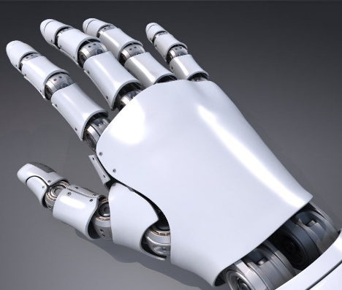
General flow of the system
Person with disability
Controllable Robotic hand
Deep
Learning
EMG
Notes:
Here, we should also talk about related works.
Briefly review the major works related to your research topic

Slide 4
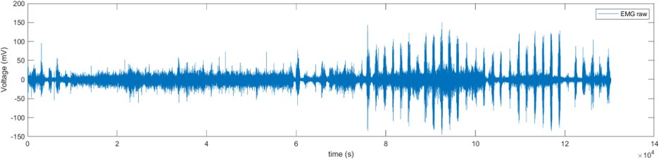
Challenges
sEMG signals are not trivial to process or decompose due to the immense complexity and high-frequency outputs of the activations occurring in skeletal muscles.
Even after preliminary amplification and band-pass filtering, extracting meaningful features from the processed signals is difficult.

Slide 5

The aim of the work
Improving the generalization performance of the methods used in certain scenarios to use under a wider range of conditions.
Providing robust and scalable heuristics such as preprocessing methods, model architectures, and training procedures for performing motion/gesture recognition from sEMG signals collected under various changing circumstances.

Slide 6
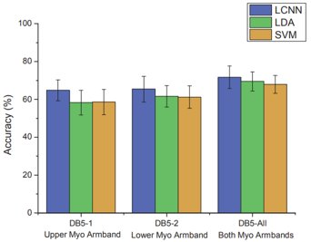
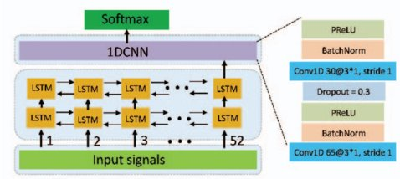
Previous Works
Dynamic Gesture Recognition Based on LSTM-CNN : LCNN​
Y. H. Wu, B. Zheng, and Y. T. Zhao, “Dynamic gesture recognition based on LSTM-CNN,” in Proc. Chinese Autom. Congr., Xi’an, China, 2018, pp. 2446−2450.

Slide 7
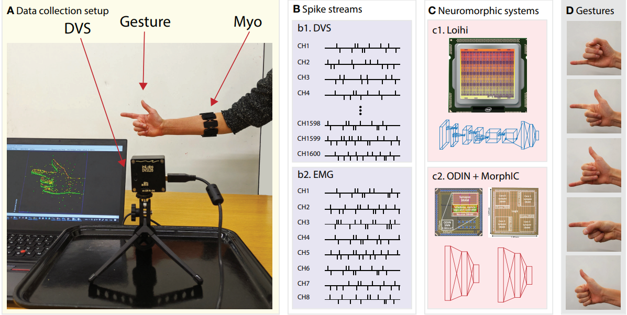
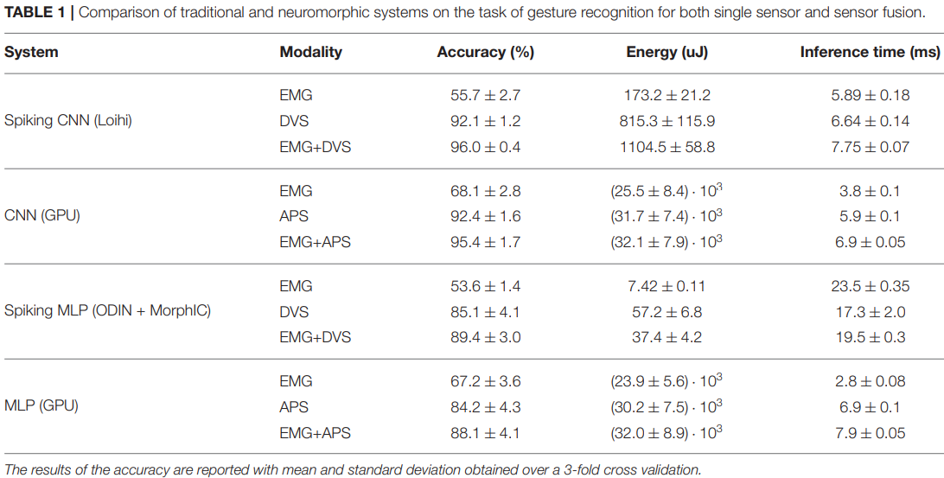
Previous Works
E. Donati, M. Payvand, N. Risi, R. Krause, K. Burelo, G. Indiveri, T. Dalgaty, and E. Vianello, “ Processing EMG signals using reservoir computing on an event-based neuromorphic system,” in Proc. IEEE Biomedical Circuits and Systems Conf., Cleveland, USA, 2018, pp. 455−458.
Notes:
Why not use camera and images to recognize gestures instead of EMG?
Gesture recognition is a task that when completed successfully will give us the ability to do a lot more applications.
Using the camera might not be always convenient (optical occlusion potential where camera does not detect the motion because of object in the way). Also, you need to be far from the camera but EMG can be worn without issues.
If we have a compact and well designed EMG device, it will be detecting the motion always.
The device will not detect more than necessary (privacy will be compromised with camera).
Can be more computationally cheap (compared to high resolution videos)

Slide 8
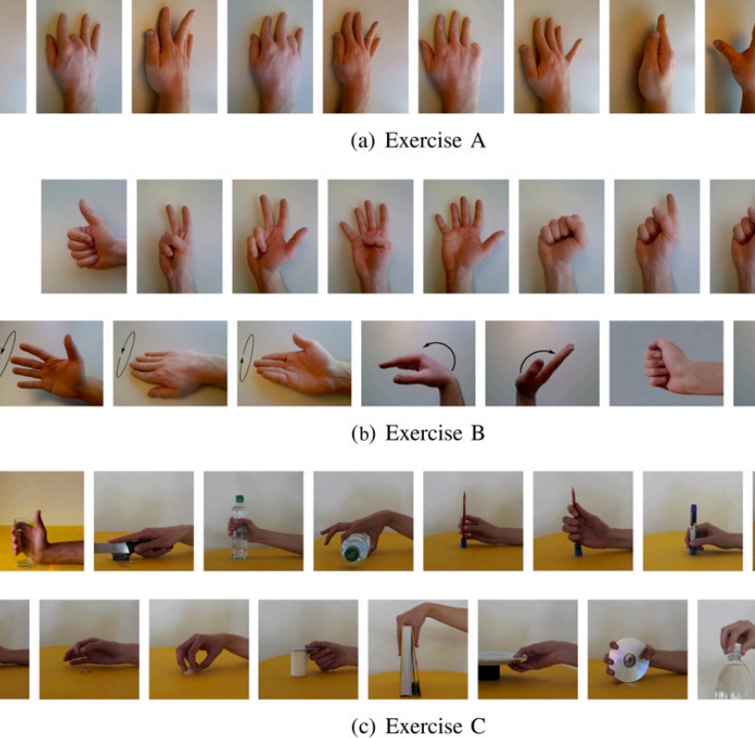
Hand Gestures Examples

Slide 9
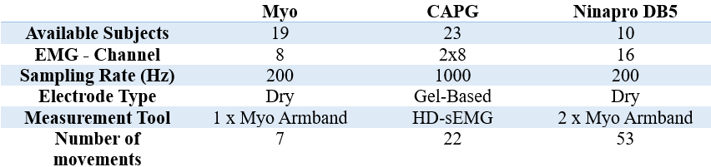
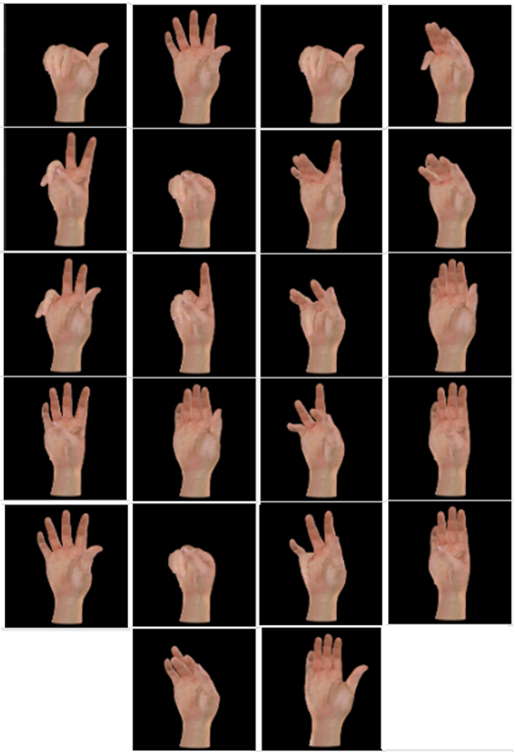
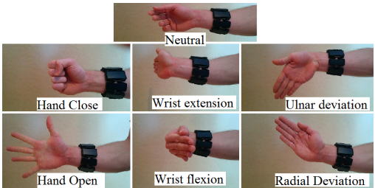
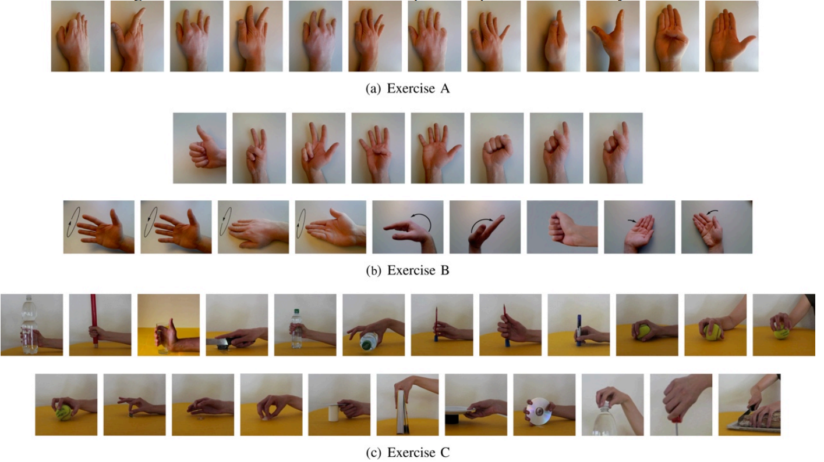
DATASETS
CAPG
Myo
Ninapro DB5
Notes:
NinaPro DB5
The dataset is divided into three exercise sets.
Basic movements of the fingers
Isometric, isotonic hand configurations and basic wrist movements
Grasping and functional movements
The set of gestures of the CAPG and MYO is a subset of the NinaPro database.

Slide 10
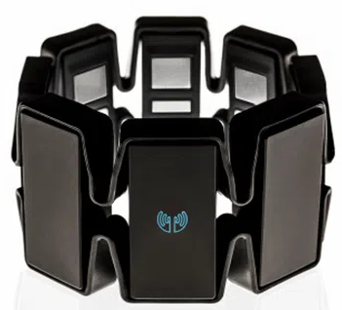
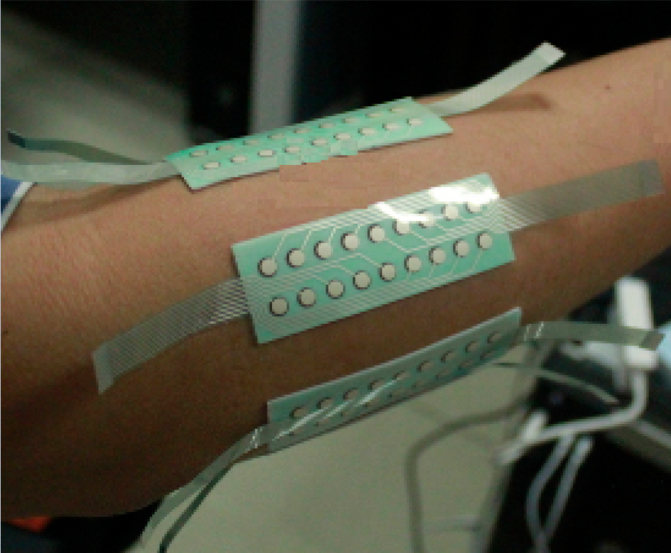
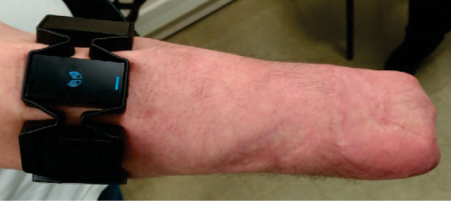
Sensor Types
Dry electrodes are less accurate and robust to motion artifact than gel-based ones.
The recommended frequency range of sEMG signals is 5-500Hz. At least 1000Hz is required.
Electrode Type | Dry | Gel-Based
Sampling Rate (Hz) | 200 | 1000

Slide 11
Approach
Analyze
Datasets and find common grounds in experimental protocols and gestures performed.
Try
State-of-the-art approaches on each dataset individually.
Evaluate
The state of the art on different conditions.
Identify
Conditions where the claimed superiority of state-of-the-art approaches diminishes.
Propose
Different architectures or methods to improve benchmarks and maintain superior results under different conditions and datasets.
Investigate
Various (pre)processing and feature extraction procedures.
Record
Effects of different (pre)processing and feature extraction procedures on model performance.
Identify
Patterns in performance and create reliable guidelines for selecting methods.
Notes:
the experiments in these datasets have been performed under a wide range of circumstances, over multiple sessions or days, with considerable variation in human subjects, sensor placement, gestures/motions chosen, time durations, etc.,
they will collectively offer a great means for comparison and contrast of models and approaches, as well as providing the opportunity to benchmark different heuristics for performing motion/gesture recognition when circumstances and protocols change dynamically.
Last Block
Identify patterns in performance and create reliable guidelines for selecting methods. based on experimental protocol, sensor type and count, preprocessing techniques, data availability, computational resources, and other factors.

Slide 12

Preliminar Results
The CAPG dataset is used.
The raw data first is filtered with a notch filter to remove the interference of the powerline at 50 Hz and its harmonics.
Then, a band-pass filter between 20-380 Hz is used to extract the useful envelope of the signal.
Notes:
Before comprehensive evaluation of the state of the art on the existing datasets, it is imperative to select one of them and then employ a standard conventional deep learning method to understand how trivial or easy it is to perform the classification task over the dataset. To this end, we will select a specific dataset and use a typical 1D CNN to perform gesture classification under a few basic circumstances while reporting their cross-validated metrics simultaneously.

Slide 13
Model Architectures
1D CNN EMGNet ConvNet

Slide 14
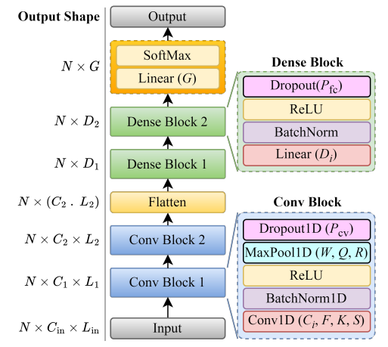
1D CNN

Slide 15
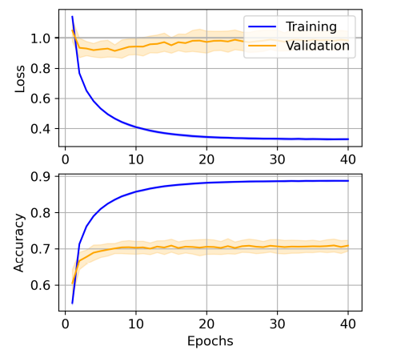
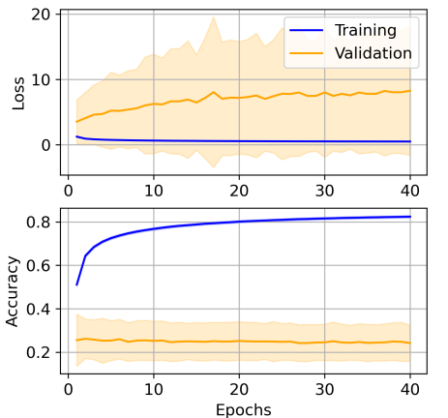
Cross Validation on 1D CNN
Minimal Testing
Subject-Dependent
9 trials out of 10 for every gesture of every subject are used for training, and one is used for testing.
17 subjects out of 18 are used for training, and one is used for testing.
Notes:
Left figure shows the overall training history for this scenario for all 10 folds of the 10-fold crossvalidation. As can be seen, there is both high bias and high variance in this scenario with the current architecture and methods.
Solid curves are means, and the shaded areas are the standard deviations. A constant epoch count of 40 without early stopping was employed.
According to both figures, the current method suffers from a high bias and high variance problem. That means that not only does the model not have the capacity to capture all the complexity of the training data, but it also cannot generalize to unseen data. To mitigate this problem, a more complex architecture will be tried in the future alongside state-of-theart model architecture in these kinds of problems.

Slide 16
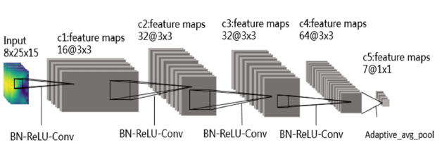
EMGNet
Notes:
Conv3D Layers

Slide 17
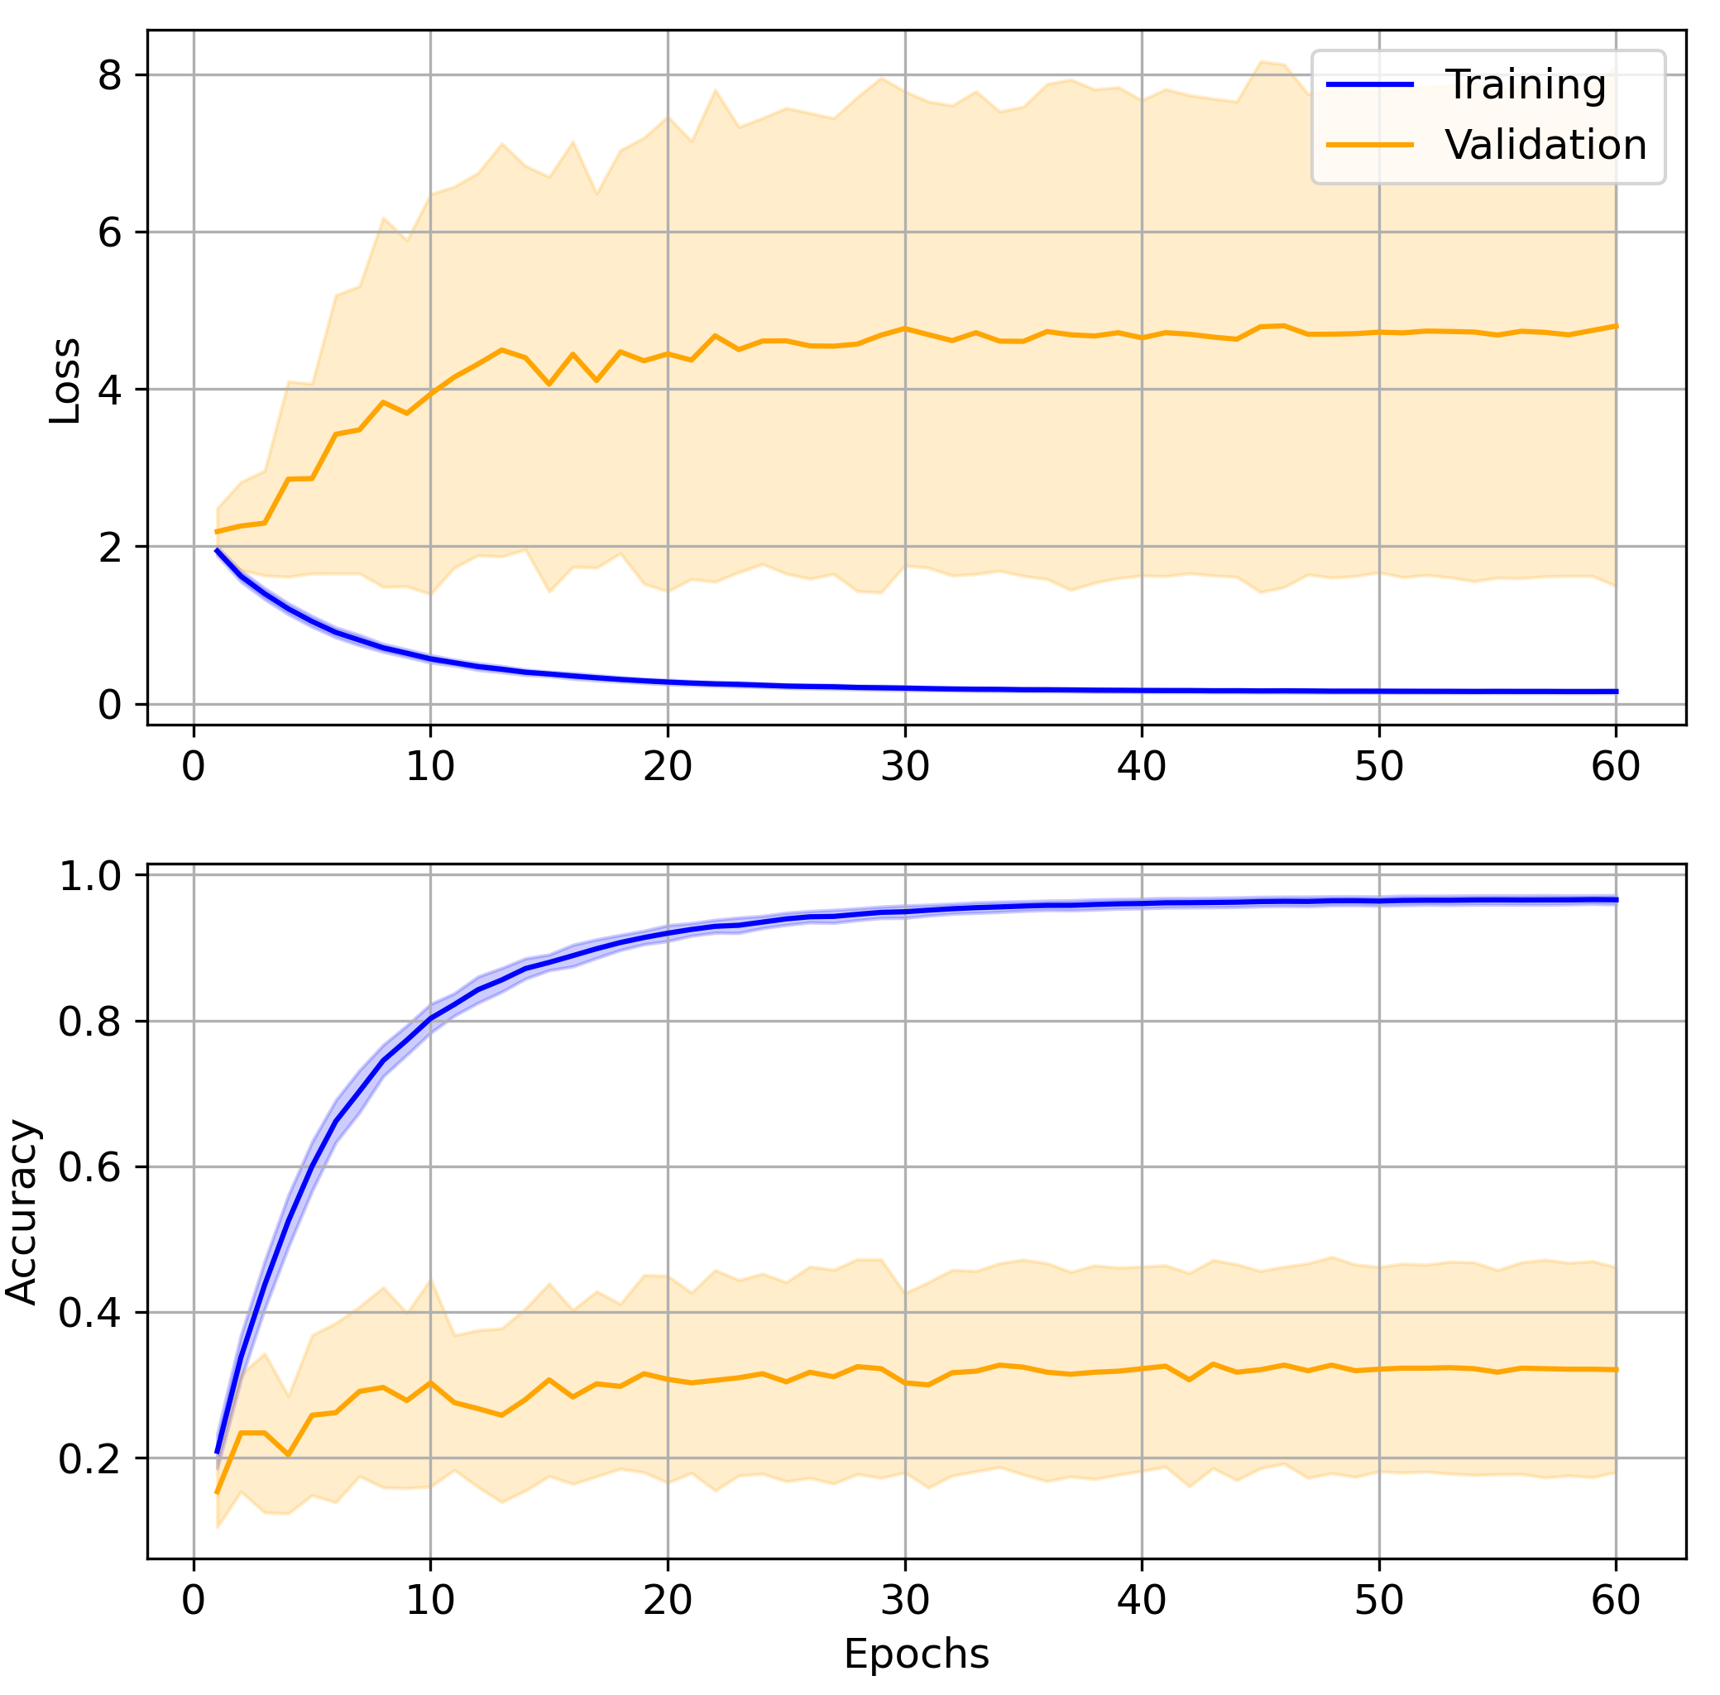
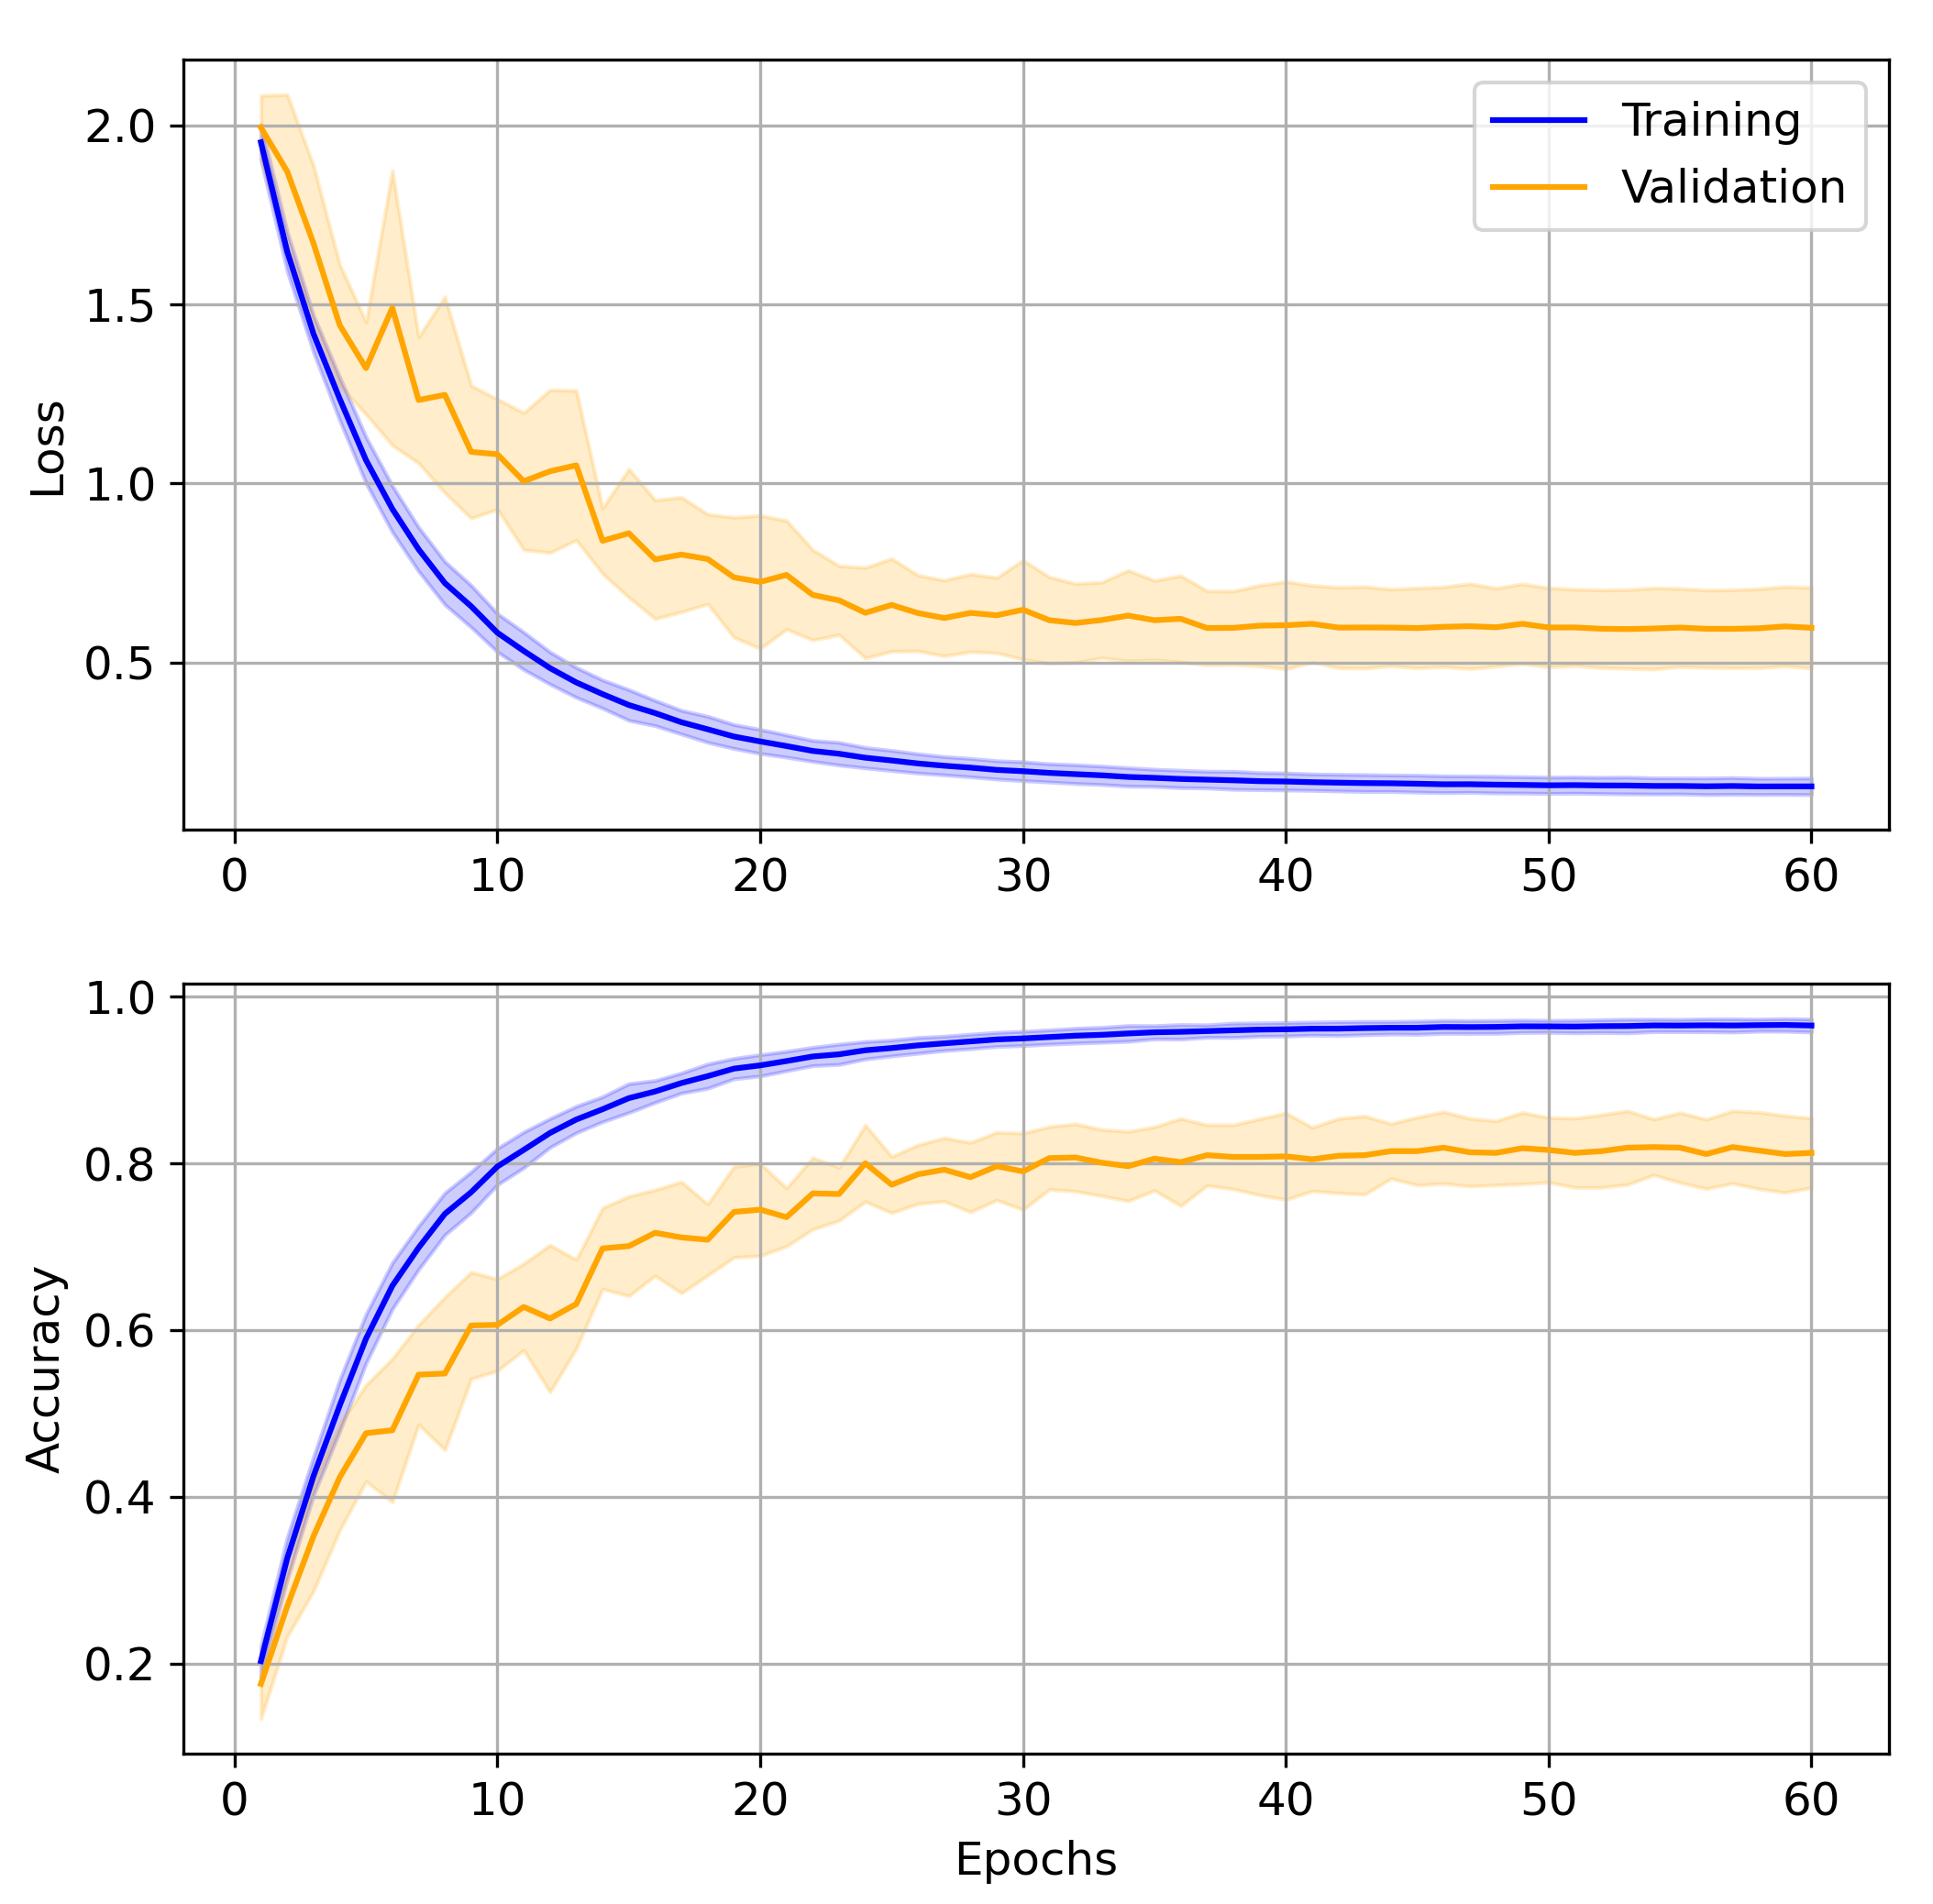
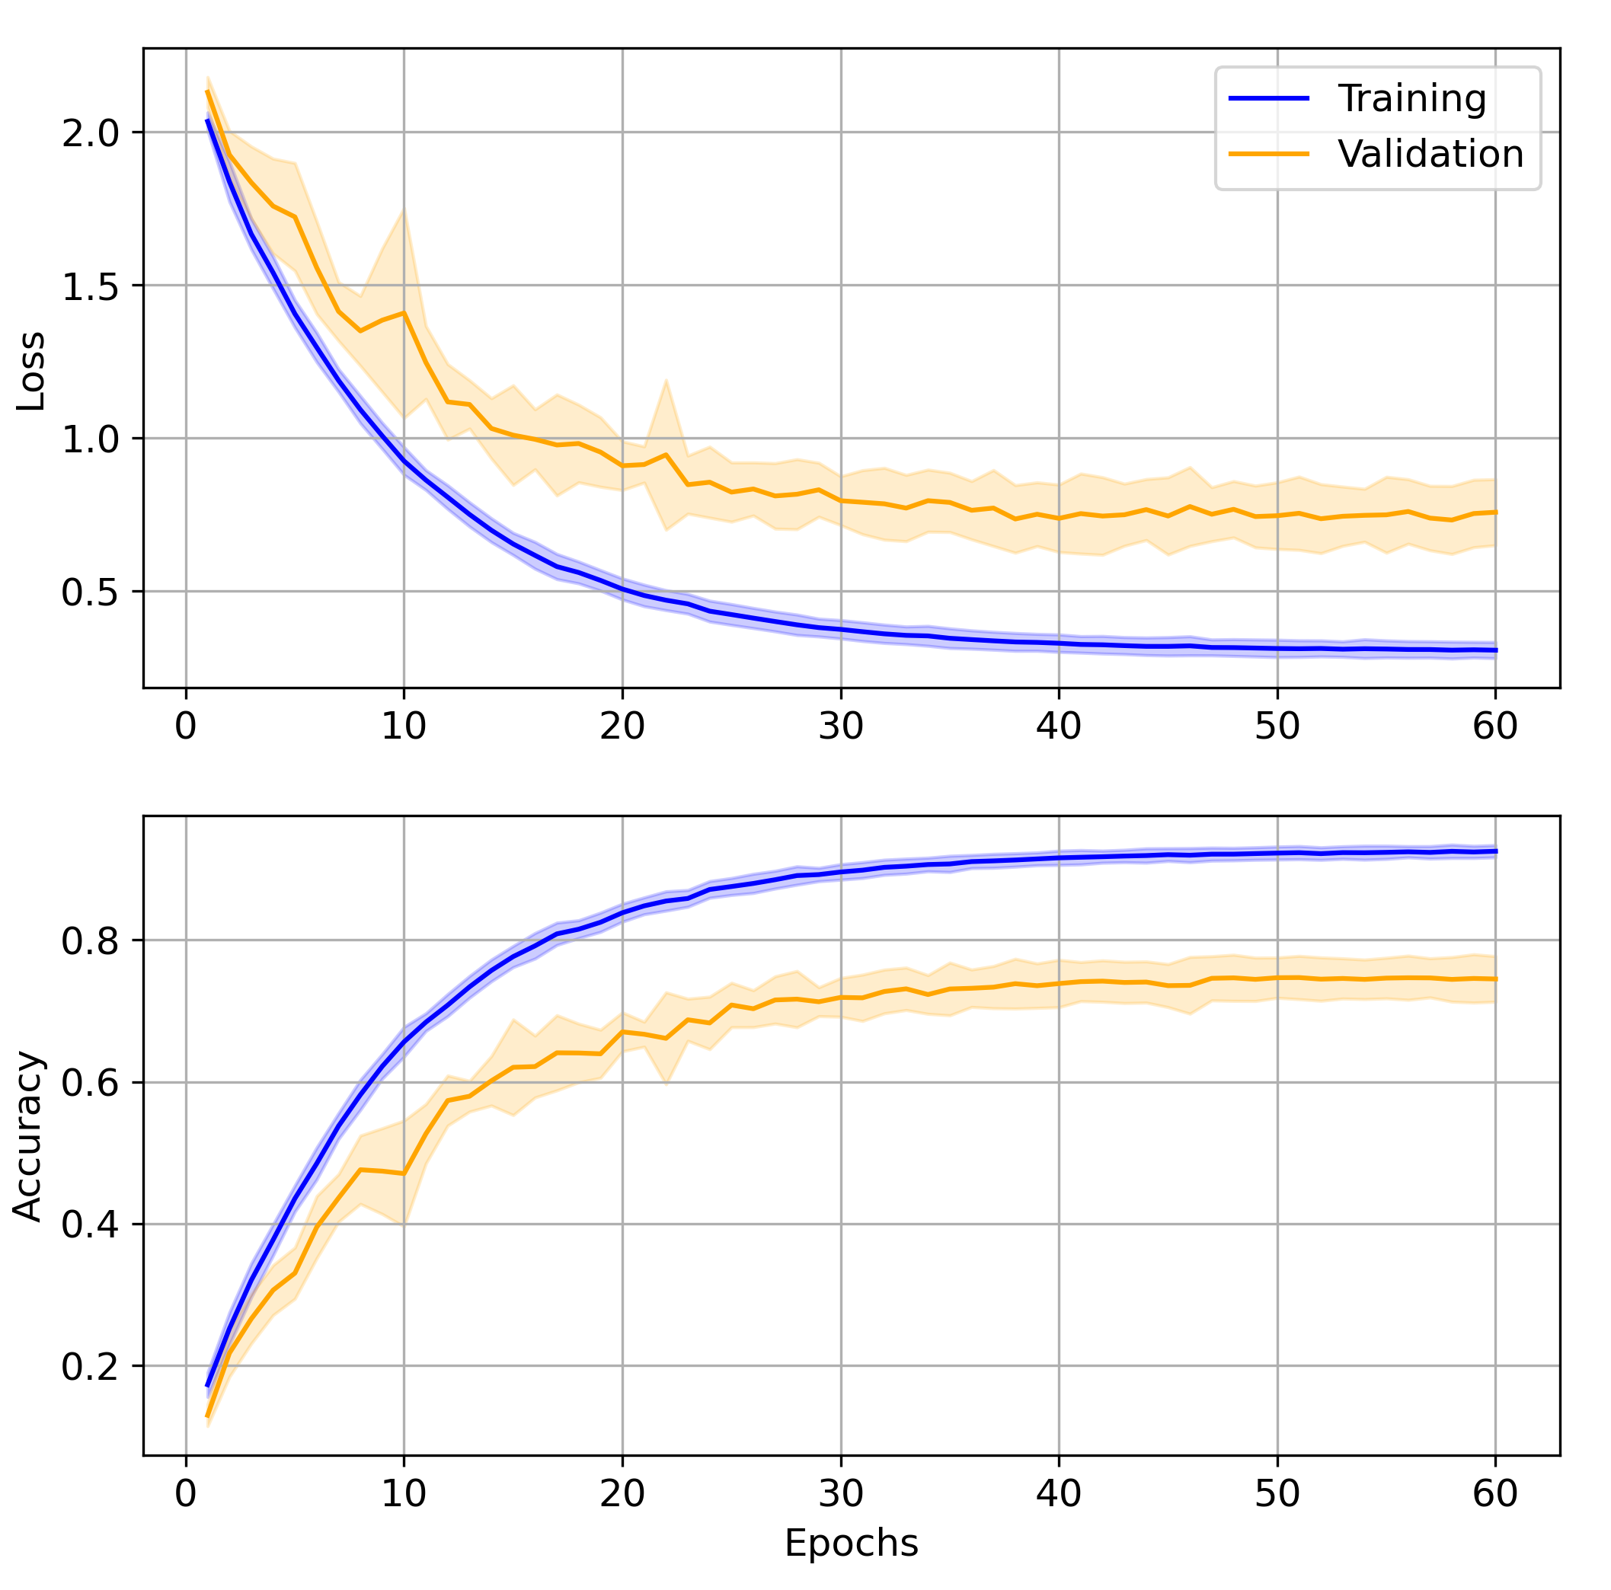
Cross Validation on EMGNet
Subject Testing
Trial Testing
5 - Trial Testing
Notes:
Since every architecture proposed in every study is typically tuned to give the best results in that study and on that data alone, there is a high likelihood that the state-of-the-art methods will not work on all kinds of datasets.

Slide 18
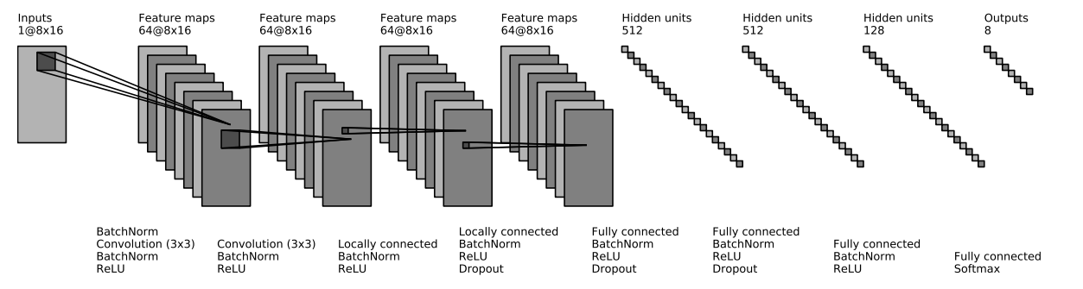
ConvNet

Slide 19
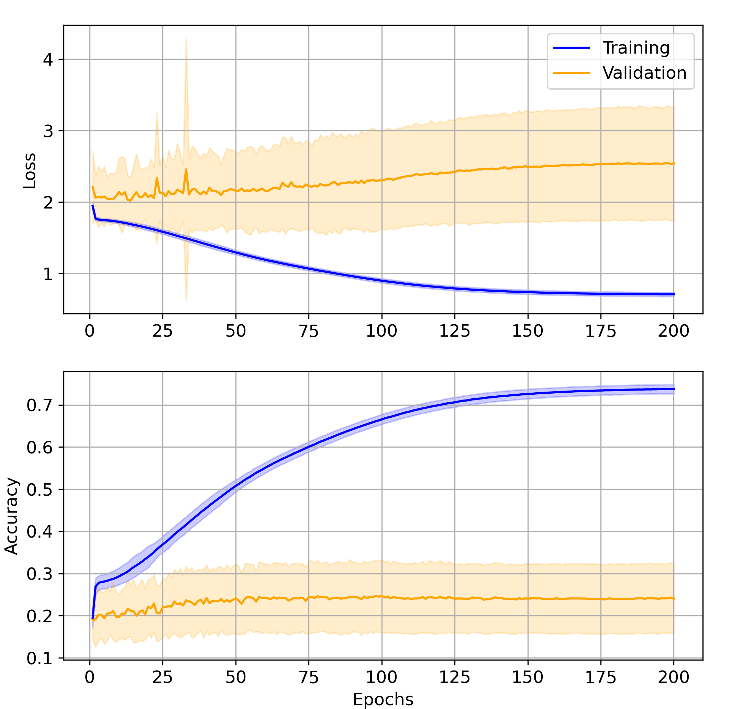
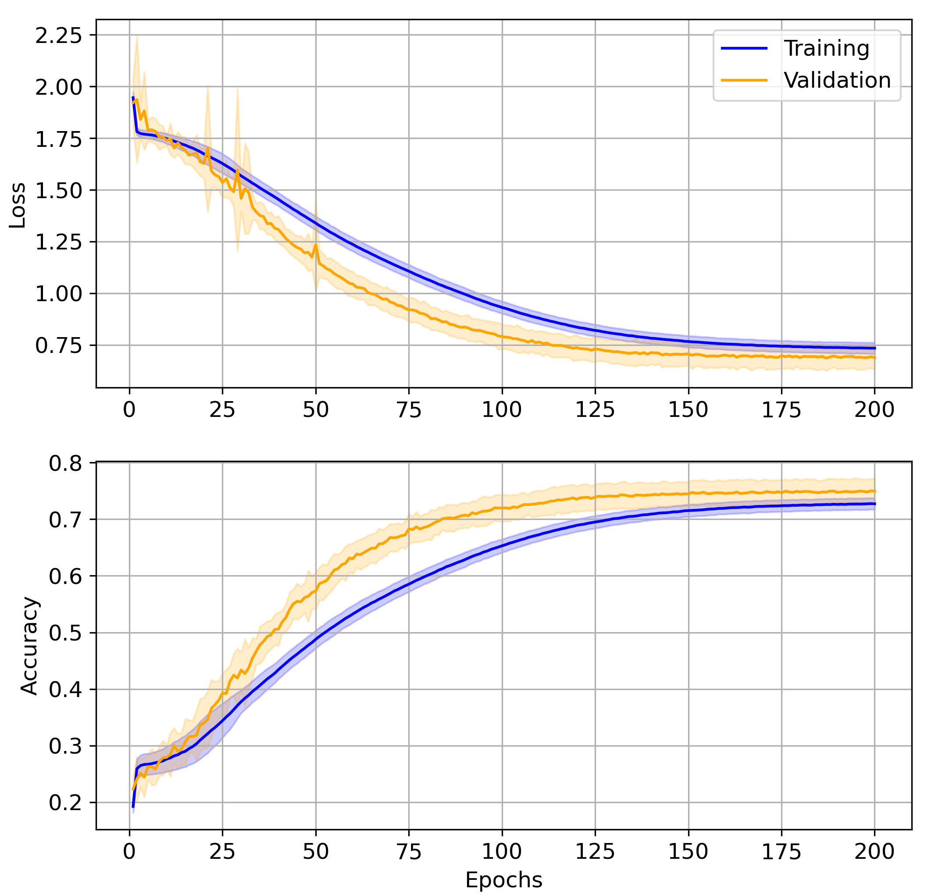
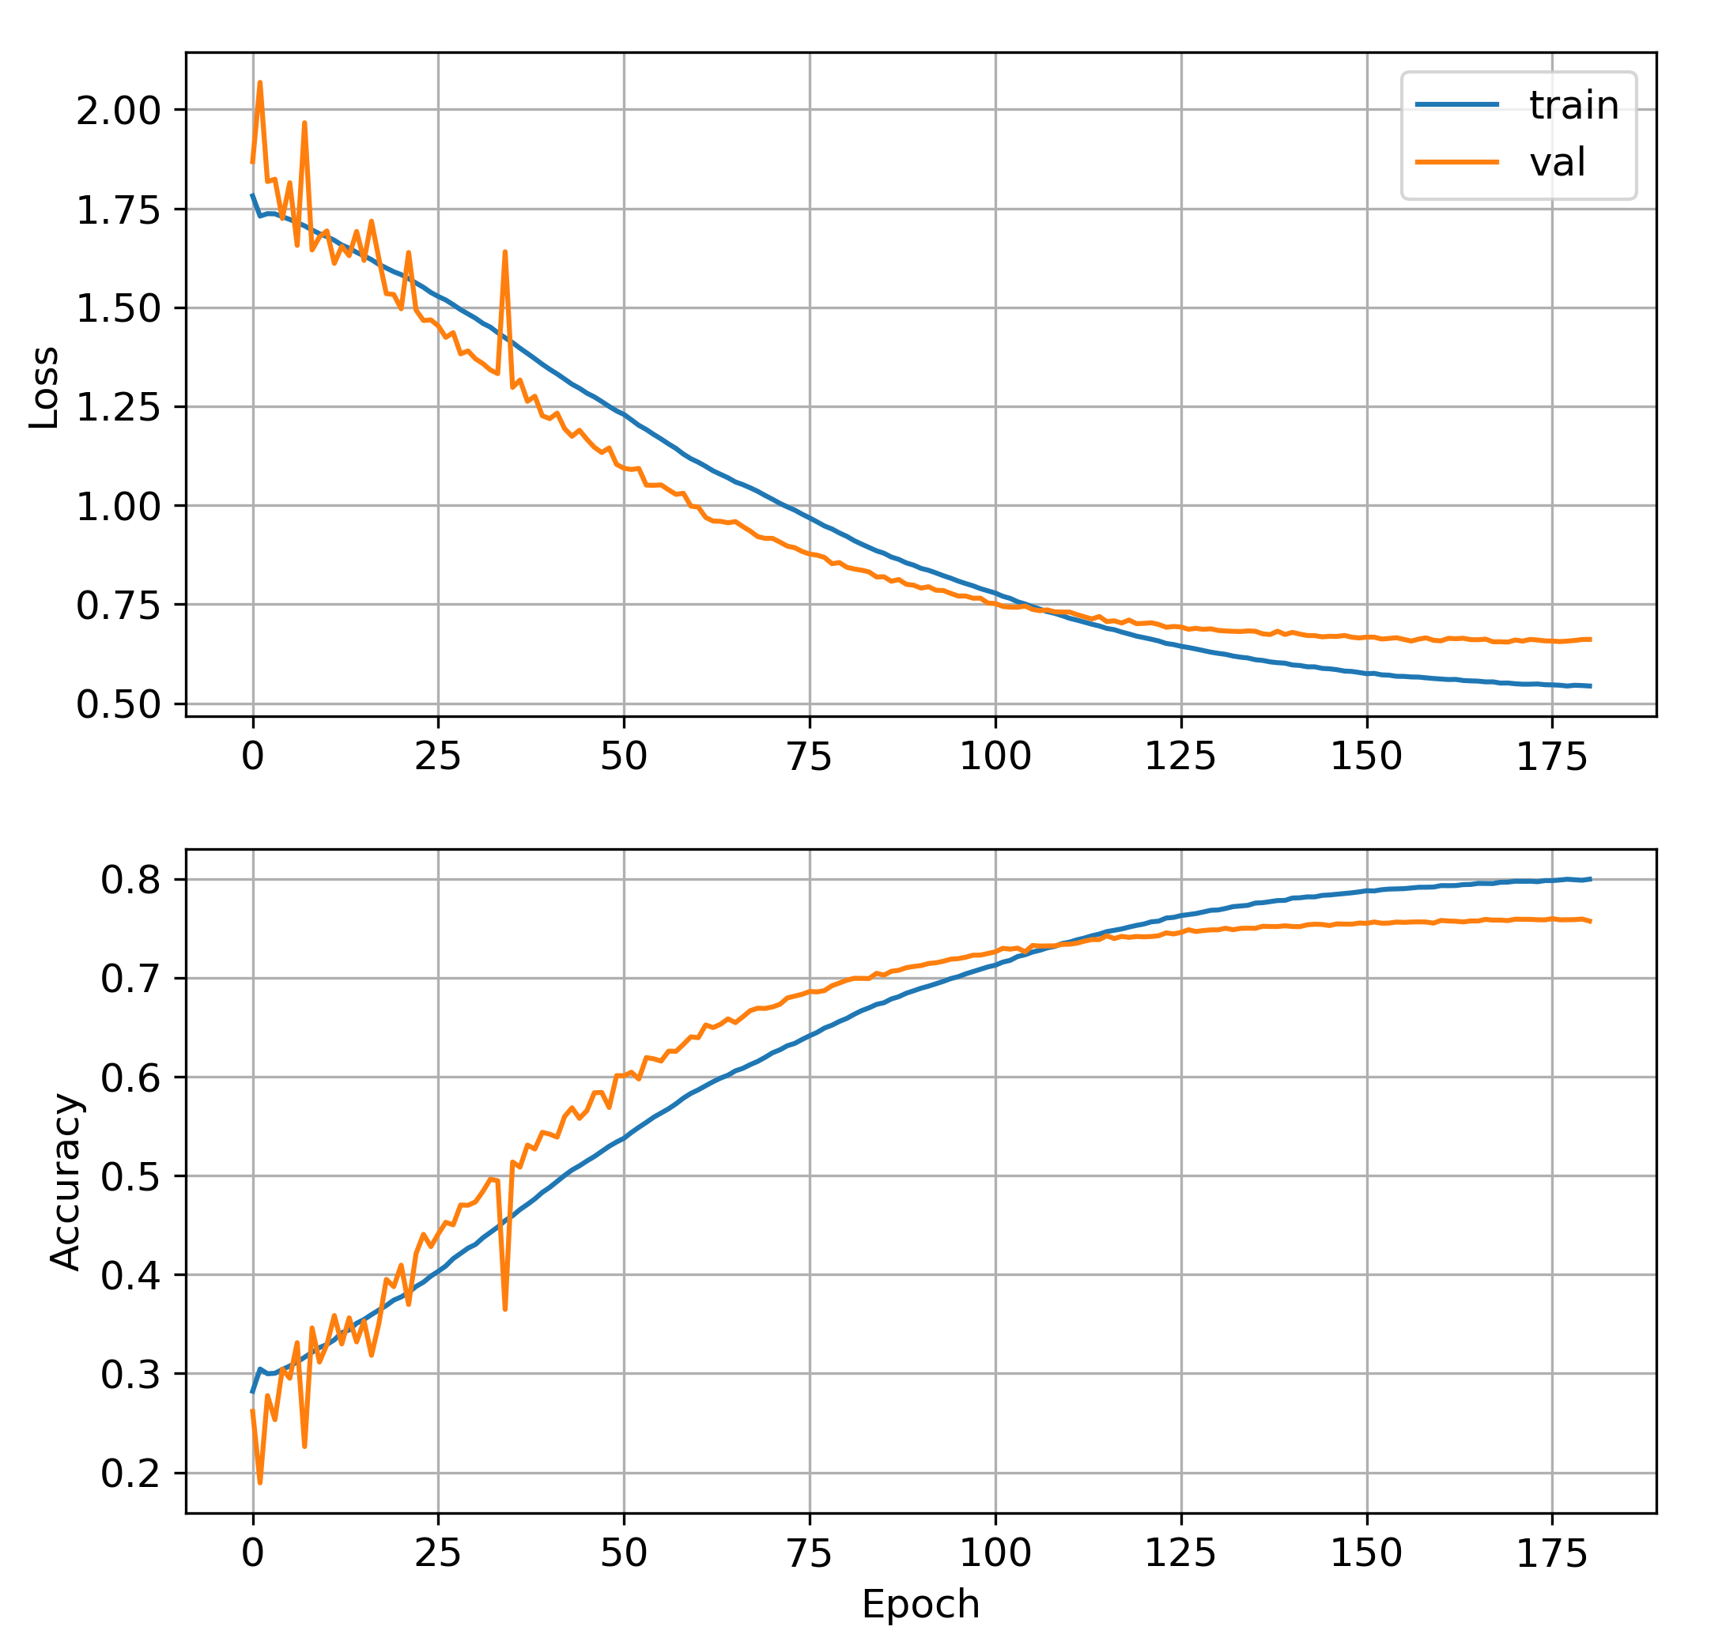
Cross Validation on ConvNet
Subject Testing
Trial Testing
5 - Trial Testing

Slide 20
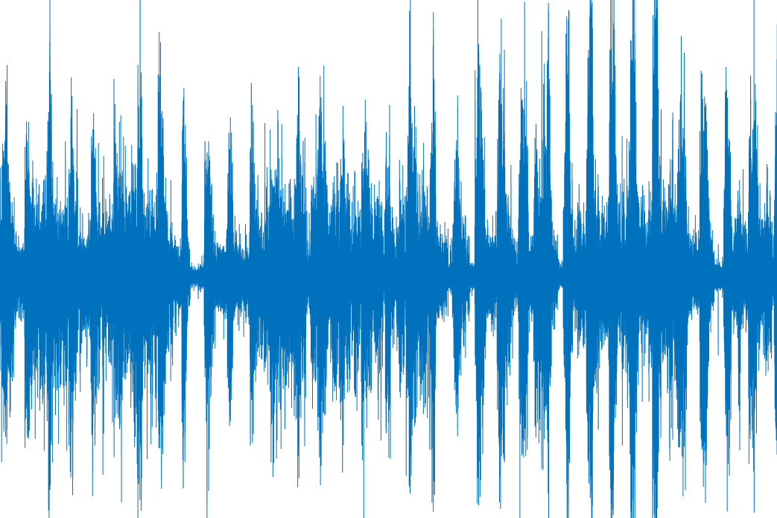
Future works
Transfer Learning will be implemented
CWT (Continuous Wavelet transform) will be implemented
SUBJECT-DEPENDENT ONE-SHOT LEARNING will be tested
SUBJECT-INDEPENDENT TESTING will be tested
Notes:
. Finally, apart from proposing more robust models with higher generalization performance on different datasets, we will also offer reliable heuristics as to which model/method to choose in every step of the procedure, depending on the type and characteristics of the experimental settings and collected data.

